Slide 1
The Threat Environment:
Attackers and Their Attacks
CIS 480 – Intro to Network Security
Computer Information Systems
University of Louisville
Ghiyoung Im, PhD

Slide 2
Learning Objectives
Define the term threat environment.
Use basic security terminology.
Describe threats from employees and ex-employees.
Describe threats from malware writers.
Describe traditional external hackers and their attacks, including break-in processes, social engineering, and denial-of-service attacks.
Know that criminals have become the dominant attackers today, describe the types of attacks they make, and discuss their methods of cooperation.
Distinguish between cyberwar and cyberterror.

Slide 3

Questions ???
Security is layered like an onion
Security is a product, not a process
Security is like a chain
知彼知己 百戰不殆 不知彼而知己 一勝一負 不知彼不知己 每戰必敗
  Make sense?
十人之守 敵難一寇 ?
Attackers mainly use technology for penetration
This course teaches hacking

Slide 4
On the Despisers of the Body -- Thus Spoke Zarathustra
“Body am I, and soul”—thus speaks the child. And why should one not speak like children?
But the awakened and knowing say: body am I entirely, and nothing else; and soul is only a word for something about the body.
The body is a great reason, a plurality with one sense, a war and a peace, a herd and a shepherd.
An instrument of your body is also your little reason, my brother, which you call “spirit”--a little instrument and toy of your great reason.
…
Behind your thoughts and feelings, my brother, there stands a mighty ruler, an unknown sage—whose name is self. In your body he dwells; he is your body.
There is more reason in your body than in your best wisdom. And who knows why your body needs precisely your best wisdom?
© faculty.frostburg.edu/phil/forum/Nietzsche.htm

Slide 5
Attackers and their Attacks
List of attackers
List of attacks

Slide 6
(ISC)²: Security Job Market Demand
Ongoing threats (good and bad!!)
Regulatory compliance demands (both vertical and geopolitical)
Greater potential for data loss via mobile devices and mobile workforce
Loss of control as organizations shift data to cloud-based services
Notes:
(ISC)2 - International Information Systems Security Certification Consortium:

Slide 7
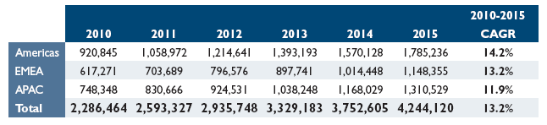
(ISC)²: Forecast for Information Security Professionals
© (ISC)² 2010

Slide 8
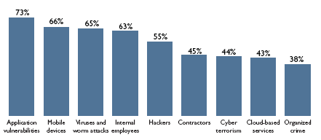
(ISC)²: Top Security Threat Concerns
© (ISC)² 2010

Slide 9
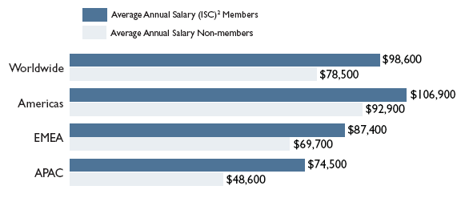
(ISC)²: Average Annual Salary by Region
© (ISC)² 2010

Slide 10
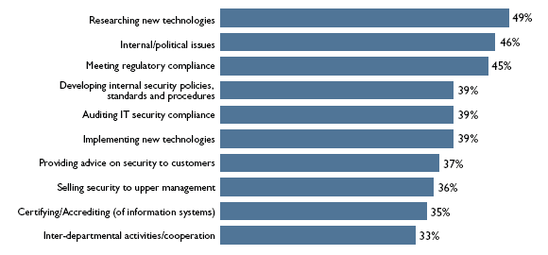
(ISC)²: Activities of Security Professionals
© (ISC)² 2010

Slide 11
Must-Have Skills, Jobs and Theories
Data security
Digital forensics
Enterprise continuity
Incident management
IT security training and awareness
IT systems operations and maintenance
Network security and telecommunications
Personnel security
Physical and environmental security
Procurement
Regulatory and standards compliance
Risk management
Strategic management
System and application security
© www.govexec.com/basics/itsecurity.htm

Slide 12
IT Security Roles
Chief information officer
Digital forensics professional
Information security officer/chief security officer
IT security compliance professionals
IT security engineer
IT systems operations and maintenance professional
IT security professional
Physical security professional
Privacy professional
Procurement professional
© www.govexec.com/basics/itsecurity.htm

Slide 13
1-1: Basic Security Terminology
Threat
  The danger that an IS vulnerability can actually leas to undesirable consequences
Vulnerability
  A weakness in your systems
The Threat Environment
  The threat environment consists of the types of attackers and attacks that companies face
© Pearson Prentice-Hall 2010

Slide 14
1-1: Basic Security Terminology
Security Goals
  Confidentiality
    Confidentiality means that people cannot read sensitive information, either while it is on a computer or while it is traveling across a network.
  Integrity
    Integrity means that attackers cannot change or destroy information, either while it is on a computer or while it is traveling across a network. Or, at least, if information is changed or destroyed, then the receiver can detect the change or restore destroyed data.
  Availability
    Availability means that people who are authorized to use information are not prevented from doing so
© Pearson Prentice-Hall 2010

Slide 15
Accomplishing CIA
Given the budget limit, organizations should prioritize their security goals
Confidentiality
Integrity
Availability

Slide 16
1-1: Basic Security Terminology
Compromises
  Successful attacks
  Also called incidents
  Also called breaches (not breeches)
Countermeasures
  Tools used to thwart attacks
  Also called safeguards, protections, and controls
  Types of countermeasures
    Preventative
    Detective
    Corrective
© Pearson Prentice-Hall 2010

Slide 17
1-2: The TJX Data Breach
The TJX Companies, Inc. (TJX)
  A group of more than 2,500 retail stores companies operating in the United States, Canada, England, Ireland, and several other countries
  Does business under such names as TJ Maxx and Marshalls
© Pearson Prentice-Hall 2010

Slide 18
1-2: The TJX Data Breach
Discovery
  On December 18, 2006, TJX detected “suspicious software” on its computer systems
  Called in security experts who confirmed an intrusion and probable data loss
  Notified law enforcement immediately
  Only notified consumers a month later to get time to fix system and to allow law enforcement to investigate
  Two waves of attacks, in 2005 and 2006
  Company estimated that 45.7 million records with limited personal information included
  Much more information was stolen on 455,000 of these customers
© Pearson Prentice-Hall 2010

Slide 19
1-2: The TJX Data Breach
The Break-Ins
  Broke into poorly protected wireless networks in retail stores
  Used this entry to break into central processing system in Massachusetts
  Not detected despite long presence, 80 GB data exfiltration
  Canadian privacy commission: poor encryption, keeping data that should not have been kept
© Pearson Prentice-Hall 2010

Slide 20
1-2: The TJX Data Breach
The Payment Card Industry-Data Security Standard (PCI-DSS)
  Rules for companies that accept credit card purchases
  If noncompliant, can lose the ability to process credit cards
  12 required control objectives
  TJX knew it was not in compliance (later found to meet only 3 of 12 control objectives)
  Visa gave an extension to TJX in 2005, subject to progress report in June 2006
© Pearson Prentice-Hall 2010

Slide 21
1-2: The TJX Data Breach
The Fall-Out: Lawsuits and Investigations
  Settled with most banks and banking associations for $40.9 million to cover card reissuing and other costs
  Visa levied $880,000 fine, which may later have been increased or decreased
  Proposed settlement with consumers
  Under investigation by U.S. Federal Trade Commission and 37 state attorneys general
  TJX has prepared for damages of $256 million as of August 2007
© Pearson Prentice-Hall 2010

Slide 22
1-3: Employee and Ex-Employee Threats
Employees and Ex-Employees Are Dangerous
  Dangerous because
    They have knowledge of internal systems
    They often have the permissions to access systems
    They often know how to avoid detection
    Employees generally are trusted
  IT and especially IT security professionals are the greatest employee threats (Qui custodiet custodes?)
© Pearson Prentice-Hall 2010

Slide 23
1-3: Employee and Ex-Employee Threats
Employee Sabotage
  Destruction of hardware, software, or data
  Plant time bomb or logic bomb on computer
Employee Hacking
  Hacking is intentionally accessing a computer resource without authorization or in excess of authorization
  Authorization is the key
© Pearson Prentice-Hall 2010

Slide 24
1-3: Employee and Ex-Employee Threats
Employee Financial Theft
  Misappropriation of assets
  Theft of money
Employee Theft of Intellectual Property (IP)
  Copyrights and patents (formally protected)
  Trade secrets: plans, product formulations, business processes, and other info that a company wishes to keep secret from competitors
© Pearson Prentice-Hall 2010

Slide 25
1-3: Employee and Ex-Employee Threats
Employee Extortion
  Perpetrator tries to obtain money or other goods by threatening to take actions that would be against the victim’s interest
Sexual or Racial Harassment of Other Employees
  Via e-mail
  Displaying pornographic material
© Pearson Prentice-Hall 2010

Slide 26
1-3: Employee and Ex-Employee Threats
Internet Abuse
  Downloading pornography, which can lead to sexual harassment lawsuits and viruses
  Downloading pirated software, music, and video, which can lead to copyright violation penalties
  Excessive personal use of the Internet at work
Carelessness
  Loss of computers or data media containing sensitive information
  Careless leading to the theft of such information
Other “Internal” Attackers
  Contract workers
  Workers in contracting companies
© Pearson Prentice-Hall 2010

Slide 27
1-4: Classic Malware: Viruses and Worms
Malware
  A generic name for any “evil software”
  Created w/ malicious intent and performs its action w/o the user’s permission
© Pearson Prentice-Hall 2010

Slide 28
1-4: Classic Malware: Viruses and Worms
Viruses
  Programs that attach themselves to legitimate programs on the victim’s machine
  Spread today primarily by e-mail
  Also by instant messaging, file transfers, etc.
Classification by Target
  Boot sector infector: Infects a master boot record
  File infector: Infects executable files
  Macro virus: Infects files with macro code
© Pearson Prentice-Hall 2010

Slide 29
1-4: Classic Malware: Viruses and Worms
Macro Viruses (Macro Worms)
  A macro: a series of commands and instructions that you group together as a single command to accomplish a task automatically
    To speed up routine editing and formatting
    To combine multiple commands
  Platform independent
  Infects documents, not executable portion of code
  A virus written in a macro language in Word, Excel
  May be dangerous to open unexpected attachments in e-mails
© Pearson Prentice-Hall 2010

Slide 30
1-4: Classic Malware: Viruses and Worms
Worms
  Full programs that do not attach themselves to other programs
  Like viruses, can spread by e-mail, instant messaging, and file transfers
  In addition, direct-propagation worms can jump from one computer to another without human intervention on the receiving computer
  Computer must have a vulnerability for direct propagation to work
  Direct-propagation worms can spread extremely rapidly because they do not have to wait for users to act
© Pearson Prentice-Hall 2010

Slide 31
The Morris Worm
One of the first worms spread via the Internet
Designed to gauge the size of the Internet
Exploited known vulnerabilities in Unix sendmail, finger, and rsh/rexec, and weak passwords
Asked a new computer if it has already a copy running
  Copied itself even if the system has a copy, 1 out of 7 times
Led to the creation of CERT/CC at CMU,
© Wikipedia, 2011

Slide 32
1-4: Classic Malware: Viruses and Worms
Blended Threats
  Malware propagates in several ways—like worms, viruses, compromised webpages containing mobile code, etc.
  The Nimda attack:
    E-mail
    Windows shares
    Web servers
    Web clients
© Pearson Prentice-Hall 2010

Slide 33
1-4: Classic Malware: Viruses and Worms
Virus
  Infection mechanism: the means by which a virus spreads
  Trigger: the event or condition
  Payload
Payloads
  Pieces of code that do damage
  Implemented by viruses and worms after propagation
  Malicious payloads are designed to do heavy damage
© Pearson Prentice-Hall 2010

Slide 34
1-5: Trojan Horses and Rootkits
Nonmobile Malware
  Must be placed on the user’s computer through one of a growing number of attack techniques
  Placed on computer by hackers
  Placed on computer by virus or worm as part of its payload
  The victim can be enticed to download the program from a website or FTP site
  Mobile code executed on a webpage can download the nonmobile malware
© Pearson Prentice-Hall 2010

Slide 35
1-5: Trojan Horses and Rootkits
Trojan Horses
  Looks helpful or entertaining, but once opened, conducts unintended actions
  A program that replaces an existing system file, taking its name
Trojan Horses
  Remote Access Trojans (RATs)
    Remotely control the victim’s PC
  Downloaders
    Small Trojan horses that download larger Trojan horses after the downloader is installed
© Pearson Prentice-Hall 2010

Slide 36
1-5: Trojan Horses and Rootkits
Trojan Horses
  Spyware
    Programs that gather information about you and make it available to the adversary
    Cookies that store too much sensitive personal information
    Keystroke loggers
    Password-stealing spyware
    Data mining spyware
  Rootkits
    Take control of the super user account (root, administrator, etc.)
    Can hide themselves from file system detection
    Can hide malware from detection
    Extremely difficult to detect (ordinary antivirus programs find few rootkits)
© Pearson Prentice-Hall 2010

Slide 37
1-6: Other Malware Attacks
Mobile Code
  Executable code on a webpage
  Code is executed automatically when the webpage is downloaded
  Uses Javascript, Microsoft Active-X controls, etc.
  Can do damage if computer has vulnerability
© Pearson Prentice-Hall 2010

Slide 38
Information System Threat Categories (1)

Slide 39
Information System Threat Categories (2)
Deliberate Threats
  Mode
    Physical assault
    Falsification
    Malicious code
    Cracking
  Motive
    Fraud
    Espionage
    Vandalism

Slide 40
Information System Threat Categories (3)
Performance Level | Error Type | Examples
Skill-based level | Skill-based slips | • Data input errors • Clerical errors • Pressing the wrong button
Rule-based level | Rule-based mistakes | • Stupid defaults • Incorrect or unreliable data • Simple design flaws • Misapplication of valid rules (e.g., day light saving time) • Application of invalid rules (e.g., truncation or rounding errors, distinguishing identical names, leap year errors)
Knowledge-based level | Knowledge-based mistakes | • System crashes • Software upgrades and crashes • Severe software malfunctions • Integration problems • Procedural flaws with the system

Slide 41
Information System Threat Categories (4)
Accidental Threats
  Error
    Skill-based slips
    Rule-based mistakes
    Knowledge-based mistakes
  Catastrophe

Slide 42
CSI Computer Crime & Security Survey
Malware infection continued to be the most commonly seen attack
Respondents reported markedly fewer financial fraud incidents than in previous years
Of the approximately half of respondents who experienced at least one security incident last year, fully 45.6 percent of them reported they’d been the subject of at least one targeted attack.
Fewer respondents than ever are willing to share specific information about dollar losses they incurred.
Respondents said that regulatory compliance efforts have had a positive effect on their security programs.
By and large, respondents did not believe that the activities of malicious insiders accounted for much of their losses due to cybercrime.
Slightly over half (51.1 percent) of the group said that their organizations do not use cloud computing. Ten percent, however, say their organizations not only use cloud computing, but have deployed cloud-specific security tools.

Slide 43
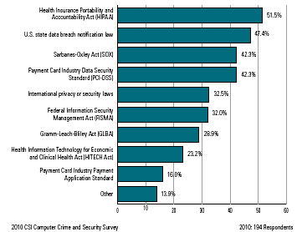
Which Laws & Industry Regulations Apply to Your Org.

Slide 44
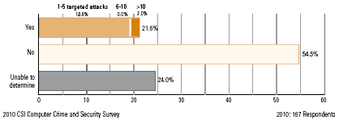
Did Any of These Security Threats Involve Targeted Attacks?

Slide 45
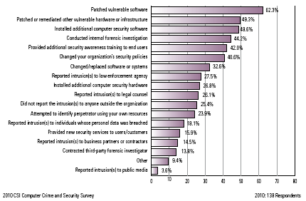
Actions Taken After an Incident
Notes:
Provide job opportunities

Slide 46
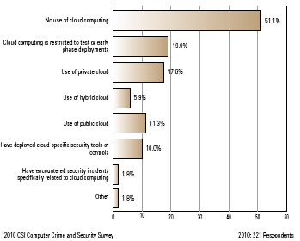
Cloud Computing

Slide 47
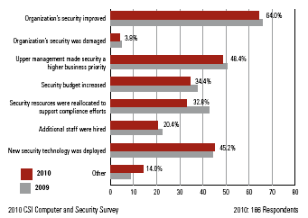
How Have Regulatory Compliance Efforts Affected Your Overall Info Security Program?

Slide 48
1-6: Other Malware Attacks
Social Engineering in Malware
  Social engineering is attempting to trick users into doing something that goes against security policies
  Several types of malware use social engineering
    Spam
    Phishing
    Spear phishing (aimed at individuals or specific groups)
    Hoaxes
© Pearson Prentice-Hall 2010

Slide 49
1-7: Traditional External Attackers: Hackers
Traditional Hackers
  Motivated by thrill, validation of skills, sense of power
  Motivated to increase reputation among other hackers
  Often do damage as a byproduct
  Often engage in petty crime
But, now …
  Kingpin
  How To Buy A Stolen Credit Card
© Pearson Prentice-Hall 2010

Slide 50
1-7: Traditional External Attackers: Hackers
Anatomy of a Hack
  Reconnaissance probes (Figure 1-8)
    IP address scans to identify possible victims
    Port scans to learn which services are open on each potential victim host
© Pearson Prentice-Hall 2010

Slide 51
1-8: Probe and Exploit Attack Packets
© Pearson Prentice-Hall 2010

Slide 52
1-7: Traditional External Attackers: Hackers
Anatomy of a Hack
  The exploit
    The specific attack method that the attacker uses to break into the computer is called the attacker’s exploit
    The act of implementing the exploit is called exploiting the host
© Pearson Prentice-Hall 2010

Slide 53
1-9: Source IP Address Spoofing
© Pearson Prentice-Hall 2010

Slide 54
1-7: Traditional External Attackers: Hackers
Chain of attack computers (Figure 1-10)
  The attacker attacks through a chain of victim computers
  Probe and exploit packets contain the source IP address of the last computer in the chain
  The final attack computer receives replies and passes them back to the attacker
  Often, the victim can trace the attack back to the final attack computer
  But the attack usually can only be traced back a few computers more
© Pearson Prentice-Hall 2010

Slide 55
1-10: Chain of Attack Computers
For probes whose replies must
be received, attacker sends
probes through a chain of
attack computers.
Victim only knows the identity
of the last compromised host
(123.125.33.101)
Not that of the attacker
© Pearson Prentice-Hall 2010

Slide 56
1-7: Traditional External Attackers: Hackers
Social Engineering
  Social engineering is often used in hacking
    Call and ask for passwords and other confidential information
    E-mail attack messages with attractive subjects
    Piggybacking
    Shoulder surfing
    Pretexting
    Etc.
  Often successful because it focuses on human weaknesses instead of technological weaknesses
© Pearson Prentice-Hall 2010

Slide 57
1-7: Traditional External Attackers: Hackers
Denial-of-Service (DoS) Attacks
  Make a server or entire network unavailable to legitimate users
  Typically send a flood of attack messages to the victim
  Distributed DoS (DDoS) Attacks (Figure 1-11)
    Bots flood the victim with attack packets
    Attacker controls the bot
© Pearson Prentice-Hall 2010

Slide 58
1-11: Distributed Denial-of-Service (DDoS) Flooding Attack
© Pearson Prentice-Hall 2010

Slide 59
1-7: Traditional External Attackers: Hackers
Bots
  Updatable attack programs (Figure 1-12)
  Botmaster can update the software to change the type of attack the bot can do
    May sell or lease the botnet to other criminals
  Botmaster can update the bot to fix bugs
© Pearson Prentice-Hall 2010

Slide 60
1-12: Fixing and Updating Bots
© Pearson Prentice-Hall 2010

Slide 61
1-7: Traditional External Attackers: Hackers
Skill Levels
  Expert attackers are characterized by strong technical skills and dogged persistence
  Expert attackers create hacker scripts to automate some of their work
  Scripts are also available for writing viruses and other malicious software
© Pearson Prentice-Hall 2010

Slide 62
1-7: Traditional External Attackers: Hackers
Skill Levels
  Script kiddies use these scripts to make attacks
  Script kiddies have low technical skills
  Script kiddies are dangerous because of their large numbers
© Pearson Prentice-Hall 2010

Slide 63
1-13: The Criminal Era
The Criminal Era
  Today, most attackers are career criminals with traditional criminal motives
  Adapt traditional criminal attack strategies to IT attacks (fraud, etc.)
© Pearson Prentice-Hall 2010

Slide 64
1-13: The Criminal Era
The Criminal Era
  Many cybercrime gangs are international
    Makes prosecution difficult
    Dupe citizens of a country into being transshippers of fraudulently purchased goods to the attacker in another country
  Cybercriminals use black market forums
    Credit card numbers and identity information
    Vulnerabilities
    Exploit software (often with update contracts)
© Pearson Prentice-Hall 2010

Slide 65
1-13: The Criminal Era
Fraud
  In fraud, the attacker deceives the victim into doing something against the victim’s financial self-interest
  Criminals are learning to conduct traditional frauds and new frauds over networks
  Also, new types of fraud, such as click fraud
© Pearson Prentice-Hall 2010

Slide 66
1-13: The Criminal Era
Financial and Intellectual Property Theft
  Steal money or intellectual property they can sell to other criminals or to competitors
Extortion
  Threaten a DoS attack or threaten to release stolen information unless the victim pays the attacker
© Pearson Prentice-Hall 2010

Slide 67
1-13: The Criminal Era
Stealing Sensitive Data about Customers and Employees
  Carding (credit card number theft)
  Bank account theft
  Online stock account theft
  Identity theft
    Steal enough identity information to represent the victim in large transactions, such as buying a car or even a house
© Pearson Prentice-Hall 2010

Slide 68
1-13: The Criminal Era
Corporate Identity Theft
  Steal the identity of an entire corporation
  Accept credit cards on behalf of the corporation
  Pretend to be the corporation in large transactions
  Can even take ownership of the corporation
© Pearson Prentice-Hall 2010

Slide 69
1-14: Competitor Threats
Commercial Espionage
  Attacks on confidentiality
  Public information gathering
    Company website and public documents
    Facebook pages of employees, etc.
  Trade secret espionage
    May only be litigated if a company has provided reasonable protection for those secrets
    Reasonableness reflects the sensitivity of the secret and industry security practices
© Pearson Prentice-Hall 2010

Slide 70
1-14: Competitor Threats
Commercial Espionage
  Trade secret theft approaches
    Theft through interception, hacking, and other traditional cybercrimes
    Bribe an employee
    Hire your ex-employee and soliciting or accept trade secrets
  National intelligence agencies engage in commercial espionage
© Pearson Prentice-Hall 2010

Slide 71
1-14: Competitor Threats
Denial-of-Service Attacks by Competitors
  Attacks on availability
  Rare but can be devastating
© Pearson Prentice-Hall 2010

Slide 72
1-15: Cyberwar and Cyberterror
Cyberwar and Cyberterror
  Attacks by national governments (cyberwar)
  Attacks by organized terrorists (cyberterror)
  Nightmare threats
  Potential for far greater attacks than those caused by criminal attackers
© Pearson Prentice-Hall 2010

Slide 73
1-15: Cyberwar and Cyberterror
Cyberwar
  Computer-based attacks by national governments
  Espionage
  Cyber-only attacks to damage financial and communication infrastructure
  To augment conventional physical attacks
    Attack IT infrastructure along with physical attacks (or in place of physical attacks)
    Paralyze enemy command and control
    Engage in propaganda attacks
© Pearson Prentice-Hall 2010

Slide 74
1-15: Cyberwar and Cyberterror
Cyberterror
  Attacks by terrorists or terrorist groups
  May attack IT resources directly
  Use the Internet for recruitment and coordination
  Use the Internet to augment physical attacks
    Disrupt communication among first responders
    Use cyberattacks to increase terror in physical attacks
  Turn to computer crime to fund their attacks
© Pearson Prentice-Hall 2010

Slide 75
The Future of Threats and
Threat Technologies (1)
Touch challenges in 2009
  Social networking sites will grow as targets
  Social engineering will become increasingly prevalent and clever
  Unlike the global economy, the underground economy will continue to flourish

Slide 76
The Future of Threats and
Threat Technologies (2)
Key Predictions
  No global outbreaks, but localized and targeted attacks.
  It’s all about money, so cybercrime will not go away.
  Windows 7 will have an impact since it is less secure than Vista in the default configuration.
  Risk mitigation is not as viable an option anymore—even with alternative browsers/alternative operating systems (OSs).
  Malware is changing its shape—every few hours.
  Drive-by infections are the norm—one Web visit is enough to get infected.
  New attack vectors will arise for virtualized/cloud environments.
  Bots cannot be stopped anymore, and will be around forever.
  Company/Social networks will continue to be shaken by data breaches.

Slide 77
The Future of Threats and
Threat Technologies (3)
New and tougher security challenges in 2010
  Cybercriminals will formulate more direct and brazen extortion tactics to obtain quicker access to cash
  Business as usual for botnets, but heavier monetization by botnet herders
  Mobile threats will have more impact
  Compromised products come straight from the factory
  Web threats will continue to plague Internet users
  Changes to the Internet infrastructure will widen the playing field for cybercriminals
  Cloud computing will present new security challenges

Slide 78

All rights reserved. No part of this publication may be reproduced, stored in a retrieval system, or transmitted, in any form or by any means, electronic, mechanical, photocopying, recording, or otherwise, without the prior written permission of the publisher. Printed in the United States of America.
Copyright © 2010 Pearson Education, Inc.
Publishing as Prentice Hall

